Slide 1

Notice of Adverse Benefit Determinations
(NABD)
2025

Slide 2
This presentation contains audio. Please click the speaker on each slide to hear the narration.
Notes:
This presentation contains audio. Please click the speaker on each slide to hear the narration.

Slide 3
NABD Training Overview
Purpose: To provide the workforce with knowledge and understanding of
the policies and procedures regarding Adverse Benefit Determinations
Objective: Staff have a basic understanding of:
1.) Definition of NABD and when it must be utilized
2.) Regulations regarding the process
3.) How to write a denial statement
4.) How to write a policy/authority citation
Notes:
Welcome to the Lakeshore Regional Entity Notice of Adverse Benefit Determination Training. Upon completion of this training, you should understand:
How an NABD is defined and when to use it
The regulations that dictate the process and how it is executed
How to properly write a denial statement
Expectations regarding citations

Slide 4
What is an Adverse Benefit Determination (ABD)?
ABDs are about SERVICE DECISIONS (42 CFR 439.400)
Service decisions are based on recipients of Medicaid services meeting medical necessity criteria for Mental Illness (MI) or Substance Use Disorder (SUD) service programs.
A Notice of ABD (NABD) is required any time a new service decision is made; an action occurs that impacts a Medicaid recipient’s services.
Notes:
An Adverse Benefit Determination is defined as any decision that denies or limits authorization of a requested service; reduces, suspends, or terminates an authorized service, denies payment of a service, or fails to provide services in the timeframes provided under 42CFR. A Notice of Adverse Benefit Determination, commonly referred to as a “NABD”, must be sent to an enrollee any time there is an action made by the CMH or Provider that impacts the services received by a recipient. While notice is required for both Medicaid and Non-Medicaid recipients, this presentation will focus on notices given to recipients of Medicaid services.

Slide 5

Laws and Policies Governing NABDs:
The following mandates provide the legal basis for the processes and procedures followed by the LRE and its Provider Panel:
MEDICAID STANDARDS
42 CFR (Code of Federal Regulations)
Medicaid Managed Specialty Supports and Services Contract
CMH/Provider Contracts
PIHP Grievance and Appeal Policy
Provider Grievance and Appeal Policy
Notes:
The legal process governing NABDs is found in part 42, subpart F, 438.400 of the Code of Federal Regulations. Adherence to this process is required by the contracts held between the Michigan Department of Health and Human Services, the Community Mental Health Service Providers, and all contracted behavioral health providers within the region. Expectations are also outlined within LRE and CMHSP policy.

Slide 6

An ABD Must Be Generated When...
Denial (in part or in whole) of payment for a service
Denial of a requested service
Reduction, Termination, or Suspension of an authorized service
Authorization of a service in an amount, duration, or scope that is less than requested
Failure to provide services within 7 calendar days of the start date agreed upon during person-centered planning
Failure to make a standard authorization decision and provide notice within 7 calendar days
Failure to make an expedited authorization decision within 72 hours of the request
Failure to resolve a grievance and provide notice within 90 calendar days
ABD acknowledgement required within the treatment plan/IPOS
Notes:
There are several circumstances when a notice of adverse benefit determination must be generated.
When a requested service or payment for a service are denied or partially denied,
When an authorized service is reduced, terminated, or suspended,
When a service is authorized in an amount, duration, or scope that is less than requested,
When an authorization decision for a requested service is not made within 14 calendar days of the request
Failure to provide services within 14 calendar days of the start date agreed upon during person-centered planning
Failure to make a standard authorization decision and provide notice within 14 calendar days of the service request
Failure to make an expedited authorization decision within 72 hours of the request for services
When a grievance is not completed or a notice of grievance resolution is not given within the 90 calendar day timeframe,
An NABD acknowledgement is required within the treatment plan or Inpatient Plan of Service. This does not need to be a copy of the NABD in its entirety, but the plan must contain information regarding the client’s right to request an appeal if they disagree with any changes to currently authorized services within their treatment plan.

Slide 7
Service Authorization Extension
Purpose:
To establish the standards that detail how LRE and its member CMHSPs will comply with federal laws and MDHHS contract requirements pertaining to service authorization timeliness and the use of extension forms.

Slide 8
Service Authorization Extension Guidelines
Must file request for extension with LRE if decision can’t be authorized within 7 calendar days from the date of request
Must demonstrate that it is in the client’s best interest
Must provide form to the LRE
Must place copy of form in client’s file
Notes:
If you cannot make an authorization decision within 14 calendar days from the date of receipt of the request for services, you must file a service authorization request with the LRE. If approved, this will grant you an extra 14 days to make the decision.
You may request an extension if you can demonstrate that it is in the client’s best interest.
A service authorization form must be filled out and provided to the LRE and placed in the client’s file.

Slide 9
Extension Form Policy
LRE and member CMHSPs may be able to extend the standard (7 calendar day) or expedited (72 hour) Service Authorization timeframes for up to an additional 14 calendar days if:​
The member requests the extension, or ​
If LRE and member CMHSPs can show that there is a need for additional information and the extension is in the member’s best interest.

Slide 10
Extension Form Policy Continues…
If LRE and member CMHSPs extend the time NOT at the request of the Enrollee, we must: ​
Make reasonable efforts to give the member prompt oral notice of the delay​
Within 2 calendar days, provide the Enrollee written notice of the reason for the decision to extend the timeframe and inform the Enrollee of the right to file a Grievance if he/she disagrees with that decision; and ​
Issue and carry out the determination as expeditiously as the Enrollee's health condition requires and no later than the date the extension expires. ​
An Extension Form must be completed and saved within the member CMHSPs EMR as well as provided to the LRE via email to Tom Rocheleau, LMSW at tomr.lsre.org

Slide 11
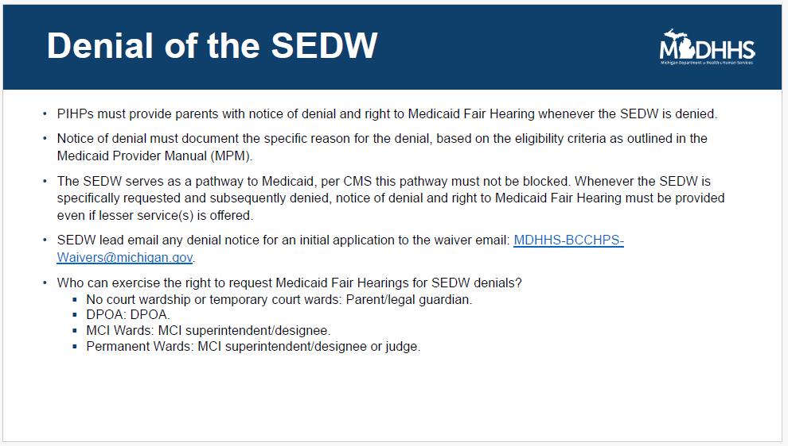

Slide 12
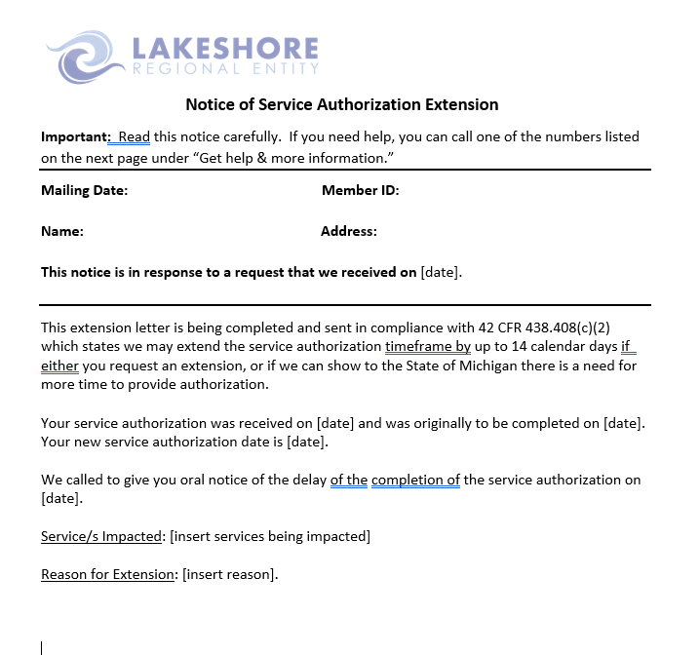
Service Authorization Extension Form

Slide 13
Extension Form References
REFERENCES AND SUPPORTING DOCUMENTS
42 CFR 438.408(c)(2)
RELATED POLICIES AND PROCEDURES
LRE Utilization Management Policy 5.0
Service Authorization Extension Notification 5.16
Service Authorization Extension Procedure 5.16a
MDHHS G&A Technical Requirement​
42CFR 438.210 (d) and 438.404 (c) (4).

Slide 14

Required Recipients of Notice of Adverse Benefit Determinations (NABD, NOABD)
The Enrollee must be provided written notice. 42 CFR 438.404(a); 42 CFR438.210(c).
The requesting provider must be provided notice when a requested service is denied or authorized in an amount, duration, or scope that is less than requested. Notice to provider does not need to be in writing. 42 CFR 438.210(c).
Notes:
42CFR states that written notice in the form of an NABD must be given to the enrollee. This includes parents of minors, guardians, or authorized representatives. If a provider is requesting a service which is denied or is less than requested, notice must be given to the provider. However, notice to the provider does not need to be in writing.

Slide 15
Timing of NABD
Individuals must receive notice whenever an adverse benefit determination (ABD) is made. There are two types of notice:
Advance Notice:
  Advance notice of ABD is used when an adverse benefit determination reduces, suspends, or terminates a service an individual is currently receiving (current authorization).
It must be given at least 30 calendar days before the effective date of the action. 42 CFR 438.404(c)(1); 42 CFR431.211.
Adequate Notice:
  Adequate notice of ABD is used when an adverse benefit determination is made to deny or limit requested services or payment. It is given at the time of the denial of the request. 42 CFR 438.210(d)(1)-(2); 42 CFR 438.404(c)(2-6).
  Note: A “reauthorization” is a new request for services requiring an adequate notice if the services are limited or denied.
A copy of the NABD must be kept in the client’s record.
Notes:
NABDs can be divided into two categories: “advance” notice and “adequate” notice. The NABD is the same template, but they vary in regard to the timing in which the notice must be given.
An advance notice is used when there is a change regarding a service that the individual is currently receiving. The authorization must be active. The NABD must be provided at least 10 calendar days prior to the effective date of the action.
An adequate notice is used when the individual asks for a new service or payment of a service but is denied. There are no active authorizations. The NABD must be given at the time of the denial.
If an individual’s services are being reauthorized (such as during an update to the IPOS), an NABD must be given if existing/requested services are limited or denied.
It is important to remember to always place a copy of the NABD into the client’s record.

Slide 16
Requirements for Medicaid NABD
A Medicaid notice of adverse benefit determination must contain the following information:
Notification that 42 CFR 440.230(d) provides the basic legal authority for an agency to place appropriate limits on a service based on such criteria as medical necessity or on utilization control procedures.
A description of the adverse action being taken
The reason(s) for the ABD and policy/authority relied upon in making the determination
Notification to the individual of their right to request, at no cost, reasonable access to and copies of all documents, records, and other information relevant to the ABD (including medical necessity criteria, any processes, strategies, or evidentiary standards used in setting coverage limits).
Notification of the individual’s right to request an appeal
Notification of the right to request a State Fair Hearing if they disagree with the results of the appeal
Notes:
Information must be present on the NABD that gives the client a clear understanding of the reason for the notice and additional rights that the individual has when filing an appeal. The specific information that is needed includes:
Notification that 42 CFR provides the basic legal authority for the CMH to limit services appropriately
A description of the action that is being taken that effects the individual’s services
A clear reason for WHY that action is being taken in language that the individual can understand
The policy/authority that was used to make the determination
Notice that the individual has the right to request copies of the documents and other information that are relevant to the action at no cost to them
Notice that the individual has the right to ask for an appeal, and the right to ask for a State Fair Hearing if the appeal is not in their favor

Slide 17
Requirements for Medicaid NABD - Continued
The circumstances under which an appeal can be expedited and how to request an expedited appeal.
When issuing an advance notice of ABD, notification of the individual’s right to have benefits continued pending resolution of the appeal, instructions on how to request benefit continuation, and a description of the circumstances (consistent with State policy) under which the individual may be required to pay the costs of the continued services.
A description of the procedures the individual is required to follow in order to exercise any of these rights.
An explanation that the individual may represent themselves or use legal counsel, a relative, a friend, or other representative.
Must Utilize MDHHS Notice of Adverse Benefit Determination Template, including taglines
Notes:
Information regarding expedited appeals
Information regarding continuation of benefits
An explanation that with written consent, an individual may name a representative of their choice
You must use the MDHHS Notice of Adverse Benefit Determination template, including taglines

Slide 18
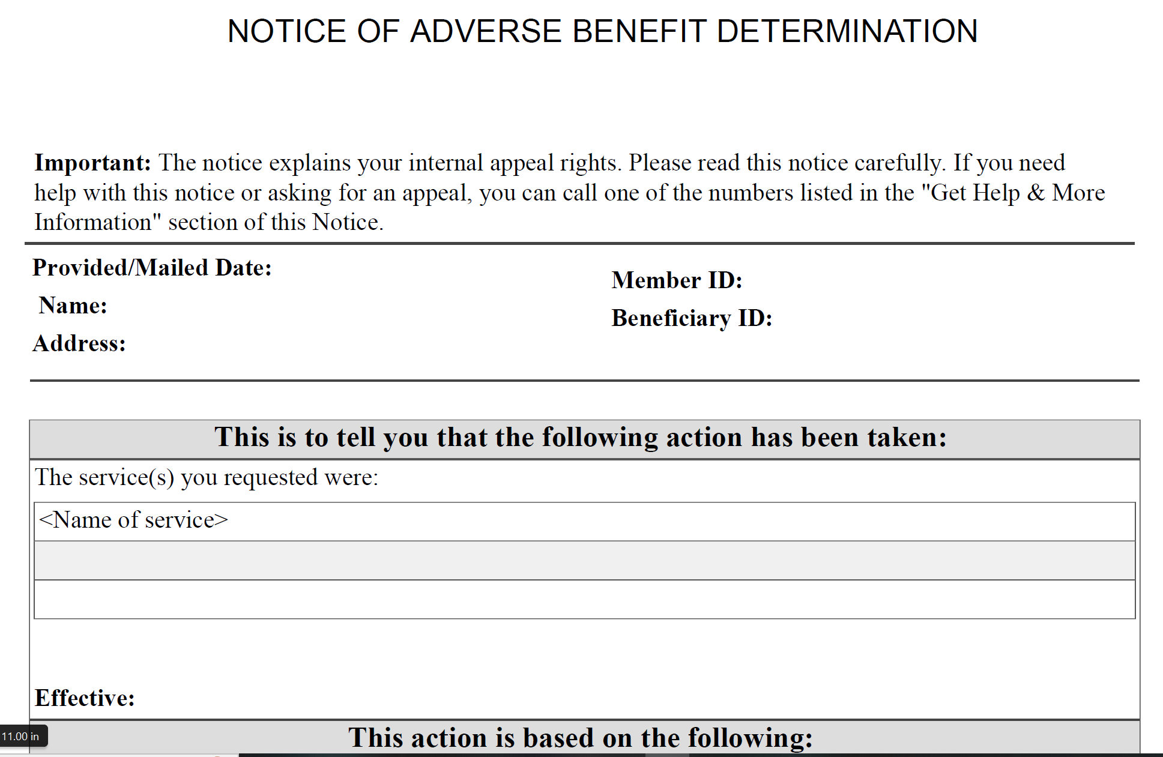
Anatomy of a NABD: State-Mandated Form
Date you mail/give the notice
What happened? Denied, termination, etc.
List ALL services affected
The effective date of the action
1
2
3
4
Notes:
This is an example of the NABD template that is mandated for use by the state.
Section 1 must contain the date that the NABD was mailed as well as the individual’s name and member information.
Section 2 is where you must tell the client what is happening to their services: Denied, terminated, delayed, etc.
Section 3 is where the name of the service or services that are affected. Please list ALL affected services.
Section 4 must contain the effective date of the action.

Slide 19
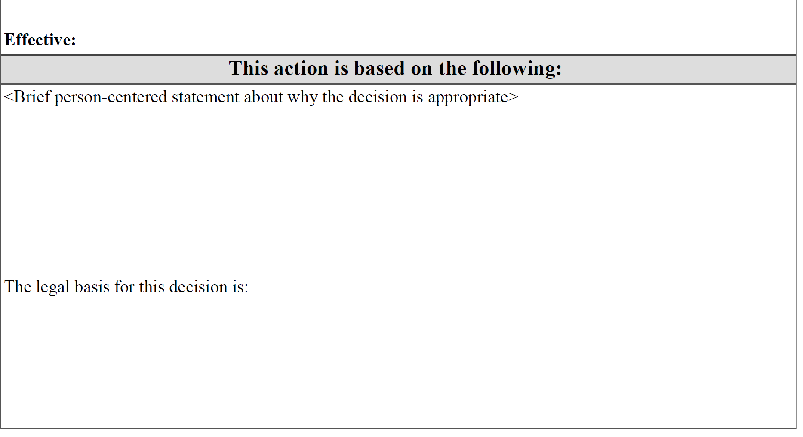
Anatomy of a NABD (Continued)
This is where your denial statement goes
This is where you place your citations/legal references you used to make your decision
5
6
Notes:
Section 5 is where you must put your denial statement. This must be a clear description of why the action occurred in language that the client will understand. For example: if the client didn’t meet medical criteria for inpatient SUD, you must specifically state the reason, such as “you have been to treatment 3 times in the past year and left early each time.” Many appeals and state fair hearings can be avoided through clear denial statements.
Section 6 is the area for placing your legal citations. These citations must match the service description. For example: If the individual was denied inpatient hospitalization, you must cite the specific section of the Mental Health Code and/or associated rules and guidelines that govern inpatient hospitalization. This citation is in addition to the citation that is required from 42 CFR which allows appropriate restrictions and denials.

Slide 20

Readability in Member Materials
42CFR 438.10 (6)(i) states:
(6)“...require [MCOs, PIHPs] entities provide all written materials for potential enrollees and enrollees consistent with the following:
(i)Use easily understood language and format
LRE Policy 6.0 and 6.9
Mental Health Code
MDHHS Contract/Grievance and Appeal Tech. Requirements
MDHHS requires that materials intended for clients or potential clients be written at or below a 6.9 grade level.
Notes:
Aside from being a best practice, person-centered writing is mandated by rules and regulations that ensure accessibility to all persons receiving Medicaid services. The Mental Health Code states that materials given to individuals must be in simple terms, explained in a way that they understand.
LRE Policies 6.0 and 6.9, Customer Services and Information and Accessibility, echo the state regulations regarding 6.9 grade reading level and a min. 12 pt font. A 6.9 grade level means that the writing is generally understood by someone who has completed the 9th month of 6th grade. This reading level is accessible to approximately 80% of the population.
42 CFR 438.10 states that all member materials should be made…in a manner and format that may be easily understood and is readily accessible by enrollees and potential enrollees” .
Accessibility rules are also found in the contract between the PIHP/CMHs/and MDHHS. State standard requirements also state that specified materials such as NABDs and Grievance notices be written to the member, and not about them. This is referred to as “consumer centricity”, which is a major part of Person-Centered writing.

Slide 21

Person-Centered Writing
About the reader/listener
Tailored to your audience
Clear, Precise, Easily Understood
Is culturally competent
Notes:
Person centered language is all about the reader, not the writer. As behavioral health professionals, we have a habit of using jargon and overly formal language regardless of who we are engaging. We are not used to taking off the clinical jacket and tailoring our writing to our audience. Person centered language is clear, precise, and effective. It presents complex information in a straight-forward way so it is more accessible and easier to read. It is in fact surprisingly difficult to use plain language to describe complicated ideas and very easy to fill text with superfluous and inflated words. Why ask the reader to wade through unnecessary words or unfamiliar jargon. We lose our client’s attention with our materials, not because they lack the intelligence to understand, but because they lack the time. This is a real barrier to knowledge for our clients. Person centered language is also culturally competent. It is respectful and inclusive and considers the wide range of diversity within our target populations.

Slide 22

How Do We Improve?
Replace fancy with plain
Use shorter words and sentences
Be personal and friendly: You, We
Use Lists
Spell out acronyms on first use
Use readability tools
Use active, not passive language
Notes:
There are several steps you can take to improve your writing on NABDs and other client materials.
Replace fancy words with more simple ones. For example: instead of conclude, use end. In addition to: also.
Avoid run-on or lengthy sentences, they will increase your reading level.
Always speak to the client, not about them: Instead of saying “Bob (or the client, recipient, etc.) was upset with the counselor”, state “You were upset with the counselor”.
Rather than having a large paragraph of text, try using bullet points/lists when possible.
Please spell out all acronyms on first use. Never assume it is understood.
I recommend utilizing Microsoft Word’s Fleish-Kincaid readability checker tool.
Use active grammatical style/voice/language, not passive. It is much more personable, readable, and concise.

Slide 23
Passive Voice Vs. Active Voice
The appeal was reviewed by the director.
The drug screen was failed by the client.
Inpatient was requested by the guardian.
Your request was considered by the CMH.
A new counselor was provided to you.
Used often in clinical or scientific writing.
Not clear or concise, can be awkward
Can sound detached, impersonal
The director reviewed the appeal.
The client failed the drug screen.
The guardian requested inpatient.
The CMH considered your request.
You were given a new counselor.
Used for most non-scientific writing.
Clear, direct, often shorter
More personal and writer-involved
Notes:
. This is an issue that is commonly seen on NABDs and grievances. In the English language, common speech patterns and grammatical rules dictate that the verb (action) comes after the subject (actor). This is called the Active voice. The box on the right gives several examples of this, such as “The client failed, the director reviewed.” This type of writing is clear, direct, personal, and used for most everyday writing.
When a person puts the verb before the subject, this is called the Passive voice. The box on the left gives examples of this, such as the drug screen was failed by the client. This type of writing is used often in clinical or scientific writing, and can be awkward, indirect, and impersonal.

Slide 24

The Hard Way:
“The provision of adequate dietary energy to ensure normal growth and development should be a principal determinant of the diets of children under five years of age.”
Notes:
Please read this sentence. It is likely that as educated individuals you have no problem understanding it. Even so, you may find it unnecessarily wordy. Now, trade your clinical jacket for Shawn’s. When you write material intended for those we serve, you HAVE to look at it through their eyes. When you do, I promise you will begin to easily identify ways to improve.

Slide 25

A Better Way:
“Children under five need calorie-rich food to ensure they grow and develop normally”.
Notes:
Now, take a look at this sentence. This has been edited to be clear and concise while maintaining the original intent of the previous sentence. It is easy to read and understand for a much larger portion of our clientele. Remember: we are not “dumbing it down”, we are “clearing it up” so it is accessible for everyone.

Slide 26
Denial Statements:
Refers to the information input by staff which informs a person that their services have been impacted.
A denial statement gives the reason, or reasons, for the notice of ABD, and the policy and/or authority that was relied upon to make the determination. It is the “story” about what services were requested, what treatment was received, what behaviors have been observed, why the care is not medically necessary, and describes the appropriate level of care, if any, available to address the person’s needs.
Denial statements must include the information necessary to support the denial of services. The information needs to be in understandable language so that the individual knows why a service is being denied.
Denial statements serve as the basis for defending a decision when there is an appeal or hearing.
Notes:
The purpose of a denial statement in an NABD is to let a person know that their services have been impacted in a negative way. This could be a denial of a requested service, a reduction, termination, or suspension of a service that they are currently receiving, or denial of a service that is less than what the client requested. This is the “story” that helps the individual understand.
It is important that the denial statement be clear, contain the necessary information to support the reason for the denial, and that it is free from error. If a case is appealed or goes to State Fair Hearing and the denial statement is not clear or accurate, it may be overturned.

Slide 27
Components of a Denial Statement
The denial rationale and evidence to support the denial.
(G&A Technical Requirements: IV(A)(4))
A specific statement about why the services are not medically necessary.
A recommendation for an alternative level of care to meet the person’s current needs, if applicable.
Identification of the specific services under review, the effective date of the authorization, a brief personalized description of why the person was receiving services (if they were), and the relevant symptoms/behaviors the person was having at the time of the request.
A description of the treatment the person received if they have been receiving services.
Notes:
A denial statement is comprised of several pieces of information including but not limited to:
The reason for the denial with supporting evidence
If not medically necessary, the specific reason as to WHY
Recommendations for alternative levels of care that meets the current need if applicable
Any relevant symptoms or behaviors that the individual was having that warranted the previous level of care and if applicable, that the reduction in care is due to a change in those symptoms or behaviors

Slide 28
Denial Statement Writing Tips
Use person-centered understandable language, not vague wording or clinical jargon.
Denial Statement Writing Tips
If a recommended level of care is included, the service must be covered by the individual’s benefit plan.
Denial statements must be written at a reading level of 6th grade or below. Grade levels can be checked by using methods such as the Microsoft Office readability statistics function, where The Flesch-Kincaid Grade Level is calculated. The level cannot be above 6.9. Try not to include the names of medications or dosages because this will increase the grade level.
Notes:
A denial statement does not have to be complicated; it should be clear and effective. This can be accomplished by remembering to use simplified language that follows common speech patterns and is at or below a 6.9 grade level, omitting unnecessary jargon or clinical language when possible, remembering that any recommendations to the individual are covered by their plan, and reviewing your denial statement for clarity prior to mailing.

Slide 29
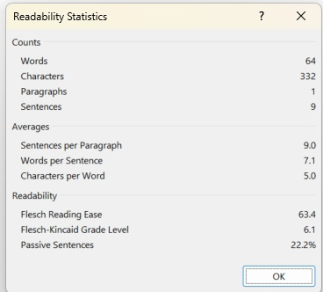
Post-Service Targeted Case Management Denial
You asked for Targeted Case Management (TCM). Your chart was reviewed. Your mental health symptoms have improved. You have stable housing. You are taking your medications as prescribed. You no longer need TCM. This service will end on 10/15/2024. You can be helped with counseling and medication management. Please speak with your Pine Rest case manager about connecting you to these services.
The following criteria was used in your case, MDHHS Medicaid Provider Manual, 23rd Ed; Behavioral Health and Intellectual/Developmental Disability-Section 13-Medical Necessity Criteria for TCM.
42 CFR 440.230(d) provides the basic legal authority for an agency to place appropriate limits on a service based on such criteria as medical necessity or on utilization control procedures.
Notes:
Let’s look at a few examples of situations you may encounter when writing a NABD. The first example is for a post-service Targeted Case Management Denial. Notice that the highlighted statement is brief, does not contain jargon, spells out the acronym on first use, gives a clear reason for the denial, and offers a recommendation for a service at a lower level of care. Beneath it is an example of an appropriate citation for this determination.

Slide 30
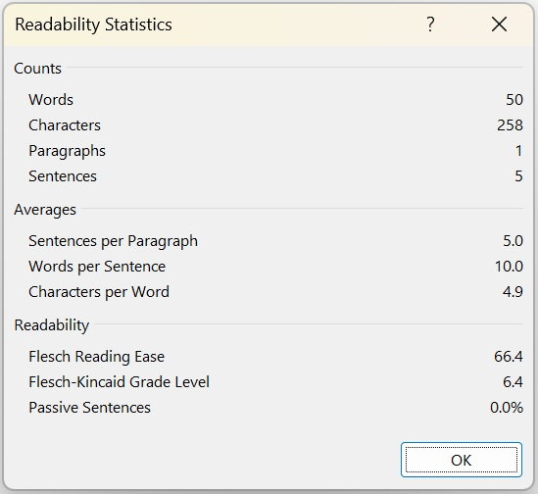
Supports Coordination Service Termination
You had supports coordination services (SC) because you wanted help with long-term employment, to explore housing options, and care for your mental health. You found a job on your own. You filled out housing applications. You now have doctors that prescribe medications. Your SC services will end on 9/29/24.
§ Reference – Per Medicaid Provider Manual section 2.1
42 CFR 440.230(d) provides the basic legal authority for an agency to place appropriate limits on a service based on such criteria as medical necessity or on utilization control procedures.
Notes:
This is an example of a termination of Supports Coordination Services.

Slide 31
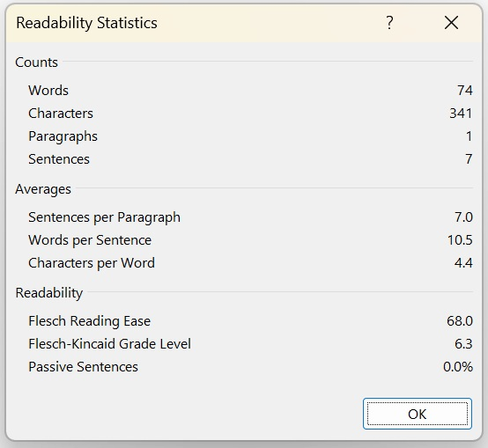
Post-Service Inpatient Mental Health Termination
On 12/23/24 you went to Trinity Health due to having thoughts to self-harm. Also, you were having difficulty taking care of yourself. You have had medication changes and are getting better. As of 12/31/24, you do not need medication changes. You can function better, and you no longer plan to hurt yourself. You can see a therapist and doctor through your Medicaid insurance. They can help you with your needs.
On 12/23/24 you went to Trinity Health due to having thoughts to self-harm. Also, you were having difficulty taking care of yourself. You have had medication changes and are getting better. As of 12/31/24, you do not need medication changes. You can function better, and you no longer plan to hurt yourself. You can see a therapist and doctor through your Medicaid insurance. They can help you with your needs.
On 12/23/24 you went to Trinity Health due to having thoughts to self-harm. Also, you were having a hard time taking care of yourself. You have had medication changes and are getting better. As of 12/31/24, you do not need medication changes. You can function better, and you no longer plan to hurt yourself. You can see a therapist and doctor through your Medicaid insurance. They can help you with your needs.
§ Reference – Per Medicaid Provider Manual section 1.6
42 CFR 440.230(d) provides the basic legal authority for an agency to place appropriate limits on a service based on such criteria as medical necessity or on utilization control procedures.
Notes:
This is an example of an Inpatient Mental Health Termination.

Slide 32
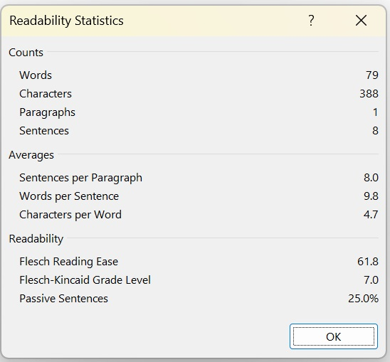
Reduction of Applied Behavior Analysis (ABA)
Your child is receiving Applied Behavior Analysis (ABA) services. You asked for 25 hours per week of ABA therapy for your new service plan period. We looked at your treatment plan. You have received center-based ABA for many years and has made progress. You can be helped with 20 hours per week of ABA. ABA should now transition to the home and into the community. More parent involvement is needed. Please speak to your Supports Coordinator with any questions.
Michigan Medicaid Manual SECTION 18- BEHAVIORAL HEALTH TREATMENT SERVICES/APPLIED BEHAVIOR ANALYSIS
42 CFR 440.230(d) provides the basic legal authority for an agency to place appropriate limits on a service based on such criteria as medical necessity or on utilization control procedures.

Slide 33
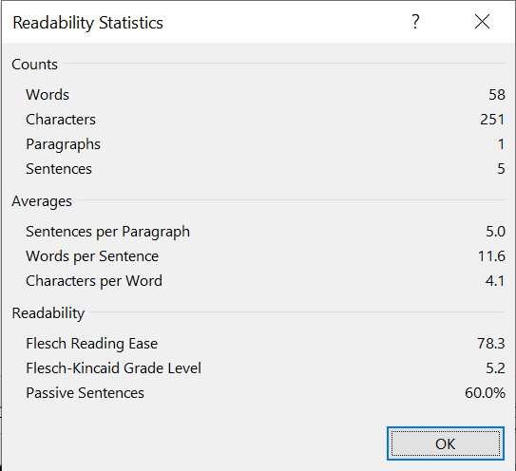
Pre-service Inpatient Detoxification Treatment Denial
You asked for inpatient detox on 1/19/25 due to your substance use. Your physical needs were assessed, and you were found to be medically stable. You do not need this level of care. You can be helped with a lower level of care. You are referred to outpatient group therapy for help with your substance use.
The following criteria was used in your case, ASAM Criteria 3.7WM for Inpatient Detoxification treatment.
Denial or limited authorization of a requested service, including determinations based on the type or level of service, requirements for medical necessity, appropriateness, setting, or effectiveness of a covered benefit. Managed Care Rule, 42 CFR 438.400 (b)(1).

Slide 34
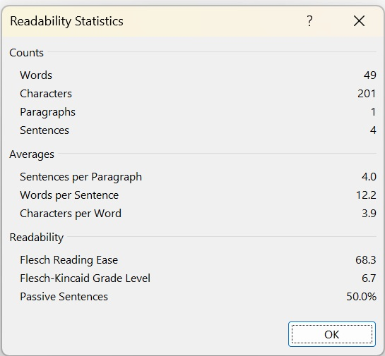
Concurrent/Post-Service Inpatient Mental Health Denial
You were admitted to Pine Rest on 12/17/2024. As of 12/24/2024 your mental health symptoms have improved, and you no longer need this level of care. You can be helped at a lower level of care. You can keep working with your case management team.
The following criteria was used in your case, MCG Health Behavioral Health Care (24th Edition) B-901 Inpatient Behavioral Health, Adult.
42 CFR 440.230(d) provides the basic legal authority for an agency to place appropriate limits on a service based on such criteria as medical necessity or on utilization control procedures.

Slide 35
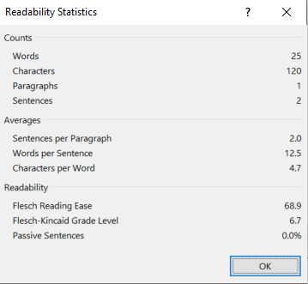
Medical Necessity Response in an NABD
You did not meet medical necessity for inpatient treatment. You have not used substances in three days and did not have any signs of withdrawal.
The following criteria was used in your case, ASAM 3.7WM for Inpatient Detoxification Treatment
42 CFR 440.230(d) provides the basic legal authority for an agency to place appropriate limits on a service based on such criteria as medical necessity or on utilization control procedures
Notes:
Medical Necessity is a common term used in the NABD explanation. For example: “You did not meet medical necessity for inpatient services.” When using this term, the actual reason that the individual did not meet medical necessity should be explained in person-centered language.

Slide 36
Additional service denial examples:
You told us on 5/1/25 that you moved to Florida on 4/25/25. You do not qualify for therapy, case management, or to see the doctor here while you are in Florida. You should call the Miami CMH to continue your services. Please call us if you move back to Muskegon County to restart services. (Reading level 6.5)
You asked for residential treatment for alcohol use because you want to start drinking again. There are many services in the community that can help you. You should call ABC Provider and ask for therapy to help you. You can also go to the Alano Club North for AA meetings to help you to not start drinking again. (Reading level 4.6).
Notes:
Here are two further examples of appropriately written denial statements. The first is for an individual who no longer lives in the service area, and the second is a denial of Substance Use Disorder residential treatment. In both of these examples, the reason for the denial is clear to the reader.

Slide 37
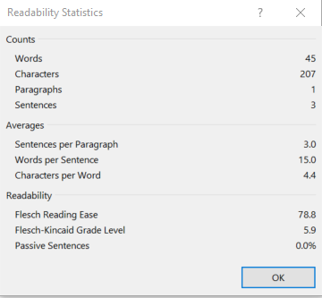
Missed Appointments
You have missed 50% of your Applied Behavior Analysis (ABA) appointments. This has made it hard for you to meet your goals. If you want to keep getting services, please reach out to your supports coordinator to look at which services would be most helpful for you.
The following criteria was used in your case: Michigan Medicaid Provider Manual Section 18: Behavioral Health Treatment Services: ABA
42 CFR 438.400(b)(2) provides the basic legal authority for an agency to reduce, suspend, or terminate a previously authorized service.
Notes:
In a NABD, explanation regarding missed appointments requires further detail. You may NOT end services because of missed appointments, but you MAY end services due to failure to meet goals because of lack of attendance.

Slide 38
Termination due to non-participation
Example: You missed 14 scheduled appointments in the last three months. You have not met your goals due to missing so many appointments. If you are interested in staying in treatment please contact your therapist by 3/14/2024 to continue services.
You have not participated in the parent training part of your Applied Behavior Analysis (ABA) services. Your child’s treatment goals are not being met due to a lack of parent involvement.
Notes:
Lack of engagement/participation is not a medically necessary reason to terminate a service. Ensure to provide documentation that will show how treatment is not progressing due to not participating.

Slide 39
  MDHHS Medicaid Provider Manual, 23rd edition; Behavioral Health and Intellectual/Developmental Disability section
  American Society of Addition Medicine’s Criteria (ASAM)
  Milliman Care Guidelines Behavioral Health Care Criteria (MCG)
  Code of Federal Regulations 42 CFR
Policy And Authority For Adverse Benefit Determinations
Notes:
Separate from the denial statement, the policy and/or authority relied upon in making the determination must be cited in the documentation notes and any correspondence sent with the notice. Most citations for Medicaid services will come from different sections of the MDHHS Medicaid Provider Manual. Substance Use Disorder information may also be found in the American Society of Addiction Medicine’s criteria, also known as ASAM. Appropriate citations may also be found in the guidelines for behavioral health care criteria through Milliman.

Slide 40
Examples of policy/authority statements:
  The following criteria was used in your case, MDHHS Medicaid Provider Manual, 23rd Ed; Behavioral Health and Intellectual/Developmental Disability-Section 13-Medical Necessity Criteria for Targeted Case Management.
  The following criteria was used in your case, ASAM Criteria 3.5WM for inpatient substance use treatment.
  The following criteria was used in your case, MCG Health Behavioral Health Care (24th Edition) B-901 Inpatient Behavioral Health, Adult.
Policy And Authority Examples
Notes:
This slide contains several examples of citations of policy and authority for NABD decisions. You must not only list the name of the document, but the specific section and item numbers where that information is found.

Slide 41
References
Title 42 of the Code of Federal Regulations
MDHHS Medicaid Specialty Supports and Services Contract
MDHHS Appeal and Grievance Resolution Technical Requirements
MI Mental Health Code
LRE Provider Service Contract
LRE Grievance and Appeal Policy 6.1
Photo Credit: www.pexels.com
Some of the information utilized was reprinted with permission from Network 180, to whom we offer our gratitude!
Notes:
References for the information contained within this presentation are listed for your convenience.

Slide 42
For Further Information:
Medicaid Managed Specialty Supports and Services Program:
https://www.michigan.gov/documents/mdhhs/PIHP_Contract_Bundle_670950_7.pdf
LRE Customer Services
1(800)897-3301
Michelle Anguiano, LMSW, CAADC Mari Hesselink, BS
CS Manager CS Specialist, SUD Rights Advisor
(231)638-9244 (231)518-4311
michellea@lsre.org marih@lsre.org
Notes:
Thank you for attending the Notice of Adverse Benefit Determination training. For further information, questions, or comments, please contact Lakeshore Regional Entity Customer Services.

